Slide 1

DEPARTMENT OF ELECTRONICS AND COMMUNICATION ENGINEERING
BUILDING A SMARTER AI POWERED SPAM CLASSIFIER
TEAM MEMBERS:
R.YUVASHREE (113321106120)
L.SUSMITHA (113321106102)
S.SWATHI (113321106103)
E.SHALINI (113321106089)
B.V.NITHYASRI (113321106064)

Slide 2
PROBLEM STATEMENT
The majority of people in today’s society own a mobile phone, and they all frequently get communications (SMS/email) on their phones. But the key point is that some of the messages you get may be spam, with very few being genuine or important interactions. You may be tricked into providing your personal information, such as your password, account number, or Social Security number, by scammers that send out phone text messages. They may be able to access your bank, email, and other accounts if they obtain this information. To filter out these messages, a spam filtering system is used that marks a message spam on the basis of its contents or sender.
Develop an AI-powered spam classifier using natural language processing (NLP) and machine learning techniques to accurately distinguish between spam and non-spam messages in emails or text messages.
The goal is to reduce the number of false positives (classifying legitimate messages as spam) and false negatives (missing actual spam messages) while achieving a high level of accuracy for sending messages.

Slide 3
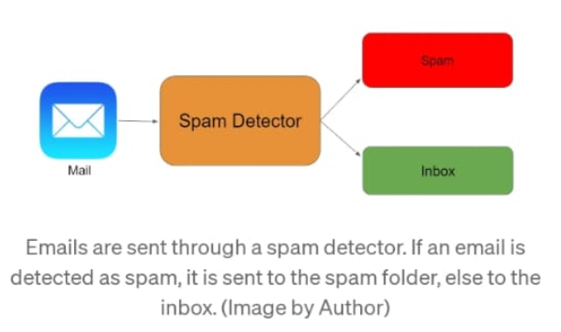
OBJECTIVES:
The main objective to use a AI based spam classifier is to detect the unsolicited and unwanted emails,we can prevent spam messages from creeping into the user’s inbox,therby improving user experience.
Building a sms spam classification model:
Split the data into train and test sets
Use Sklearn built-in classifiers to build the models
Train the data on the model
Make predictions on new data

Slide 4
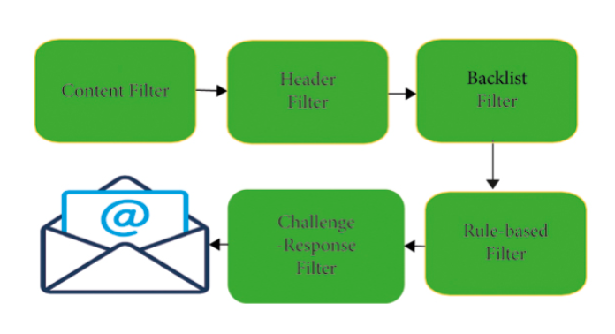
Spam Messages
The email spam definition is ambiguous since everybody has their views on it. At present, email spam is getting the attention of everyone. Email spam ordinarily includes particular spontaneous messages sent in mass by individuals you do not know. In the era of technology, the spammer shows a story where the unfortunate casualty needs forthright financial help so that the fraudster can gain a lot bigger total of cash, which they would then share. The fraudster will either earn a profit or avoid communication when the unfortunate victim completes the installment.
1.Spam Filtering Methods in Email :
The number of spam emails is rapidly increasing in marketing, chain communications, stock market tips, politics, and education . Currently, various companies develop different techniques and algorithms for efficient spam detection and filtering. We address some filtering strategies.
Method 1:The Standard Spam Filtering Method

Slide 5
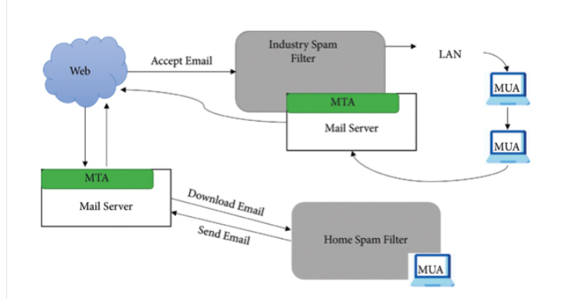
Method 2:The Client Side Spam Filtering
A client is a person who can use the Internet or email network to send or receive an email. For transmission of data, a client should deploy multiple existing frameworks on his/her system. Such systems connect with client mail agents and filter the client’s mailbox by compositing, accepting, and managing the incoming emails.
Method 3: Enterprise Level Spam Filtering
Email spam detection at the enterprise level is a technique in which various filtering frameworks are installed on the server, dealing with the mail transfer agent and classifying the collected emails into one spam or ham . This system client uses the system consistently and effectively on a network with an enterprise filtering technique to filter the emails.

Slide 6
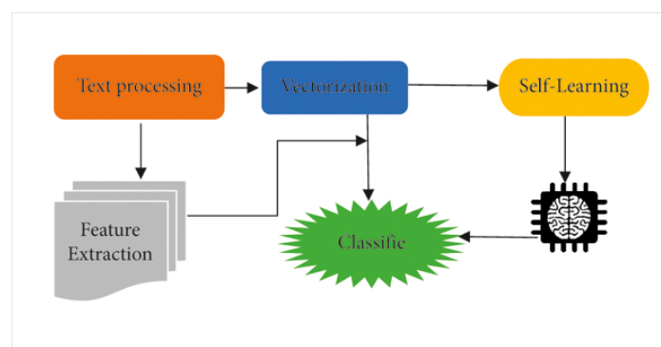
Case-Based Spam Filtering:
One of the conventional machine learning methods for spam detection is the case-based or sample-based spam filtering system . There are many phases to this type of filtering with the aid of the collection method; it collects mails during the first step.
After all the major transition continues with the preprocessing steps through the client graphical user interface, outlining abstraction, and choice of email data classification, testing the entire process using vector expression and classifying the data into two classes: spam and legitimate email.

Slide 7
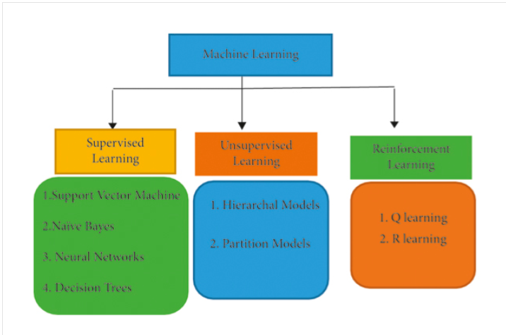
Machine Learning-Based Spam Filtering Methods:
ALGORITHM USED:
SUPERVISED LEARNING:
1.Naïve Bayes Classifier (NB):
The Naïve Bayes classifier is based on the Bayes theorem. It assumes that the predictors are independent, which means that knowing the value of one attribute impacts any other attribute’s value. Naïve Bayes classifiers are easy to build because they do not require any iterative process and they perform very efficiently on large datasets with a handsome level of accuracy. This research uses three steps for the filtration of emails, i.e., preprocessing, feature selection, and, at last, it implements the features by using the Naïve Bayes classifier. The preprocessing step removes all conjunction words, articles, and stop words from the email body. Then, they used the WEKA tool and made two datasets called spam data and spam base dataset.

Slide 8
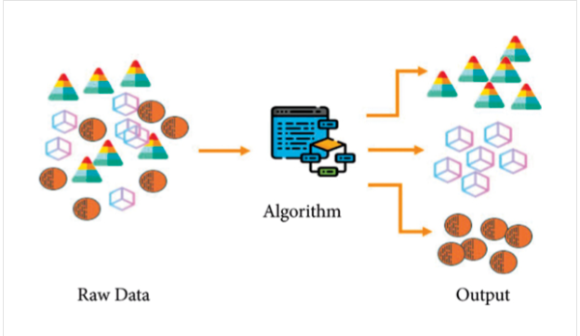
UNSUPERVISED LEARNING:
Unsupervised learning works on unlabeled data and makes clusters of the data based on the features of that data. This type of learning can be used for various problems like Recommender Systems, identifying Buying Habits, Grouping User Logs, dimensionality reduction, etc.
Hierarchical Clustering:
Hierarchical clustering identifies clusters with a hierarchy achieved either by iteratively combining smaller clusters into a more significant cluster or by splitting a more massive cluster into smaller clusters. This cluster hierarchy, generated through a clustering algorithm, is called a dendrogram . A dendrogram is one way of representing the hierarchical clusters.

Slide 9
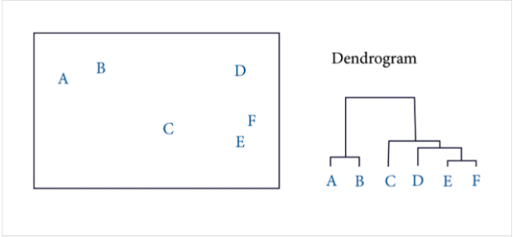
Partitional Clustering:
A partitional clustering divides a single set of data objects into non overlapping subsets so that each data object is in only one subset . Partitional clustering algorithms make different partitions of data and then evaluate the required results based on some criteria.
Reinforcement Machine Learning:
Reinforcement learning is another type of machine learning which works on reward taken from its environment. It takes suitable actions to make or get the maximum reward in a given situation. The main difference between supervised and reinforcement learning is that supervised learning needs training data with correct labels. Simultaneously, there is no correct label in reinforcement learning, but the agent decides what to do to perform the given task.

Slide 10
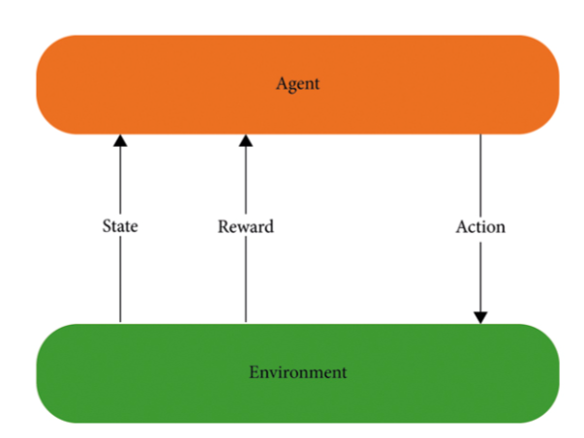
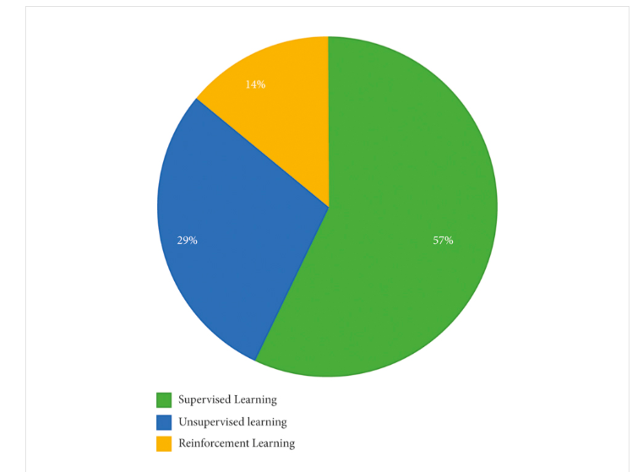
Overall Insights of the Machine Learning Algorithms for Spam Detection:
The most of the datasets used to train, test, and implement different models are synthetically created. The three learning algorithms, logistic regression, Naïve Bayes, and support vector machine (SVM), are widely used.

Slide 11
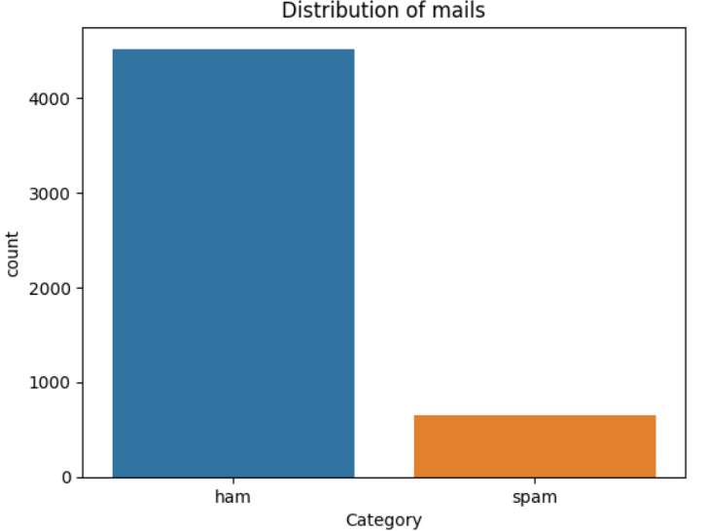
Innovation using BERT algorithm:
The innovation in the SPAM classifier is based on using pre-trained languages models like BERT algorithm . This models are performed using NLP tasks.
BERT algorithm: Bidirectional Encoder Representation from Transformers is machine learning framework for NLP. This algorithm is significantly used to improve the overall efficiency and effectiveness of e-mail systems.
Natural language processing(NLP):This is mainly used to a breakdown Human text into a smaller parts that computer programs can easily understand . To detect Spam using NLP can be done by pre-processing the e-mail by tokenizing , removing stop words and converting to a lower case .
The spam detection works under many algorithms based on the usage to detect the spam.But most of the algorithm is based on Naiive Bayes and SVC.The first step is to detect the number of spam messages in the mail.so to find that we use machine learning .
PROGRAM: sns.countplot(data=df, x='Category’)
plt.xlabel('Category’)
plt.ylabel('count’)
plt.title('Distribution of mails’)
plt.show()
This program gives the count of the sapm messages in the mail.

Slide 12
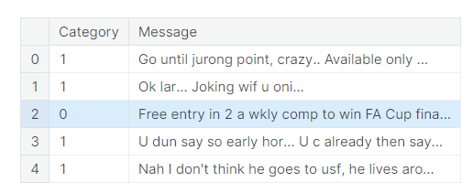
CORE COMPONENTS OF SPAM CLASSIFIER:
1.Data Preprocessing:
The text data needs to be cleaned and preprocessed. This involves removing special characters, converting text to lowercase, and tokenizing the text into individual words.
In this the output will be represents in the form of 0’s and 1’s.
If the output is 1 then it represents as HAM and if the output is 0 then it gives result as SPAM.
PROGRAM: df.loc[df["Category"] == "spam", "Category"] = 0
df.loc[df["Category"] == "ham", "Category"] = 1
df.head()
2.Feature Extraction:
This techinque is used to convert the tokenized words into numerical features using techniques like TF-IDF (Term Frequency-Inverse Document Frequency).
Assign weights to words based on their importance in the document.

Slide 13
PROGRAM:
Convert the training and testing text messages into numerical features using TF-IDF:
feature_extraction = TfidfVectorizer(min_df=1, stop_words="english", lowercase=True)
Convert the training and testing text messages into numerical features using TF-IDF:
X_train_features = feature_extraction.fit_transform(X_train)
X_test_features = feature_extraction.transform(X_test)
Convert the target values into 0 and 1:
Y_train = Y_train.astype(int)
Y_test = Y_test.astype(int)
print(X_train)
print(X_train_features)
Evaluation:
In this we used to find the accuracy,performance,recall and precision.
It evaluate the overall performance of the spam classifier.
Consider using a confusion matrix to get a better understanding of the results.Implement cross-validation to assess the model's generalization performance.

Slide 14
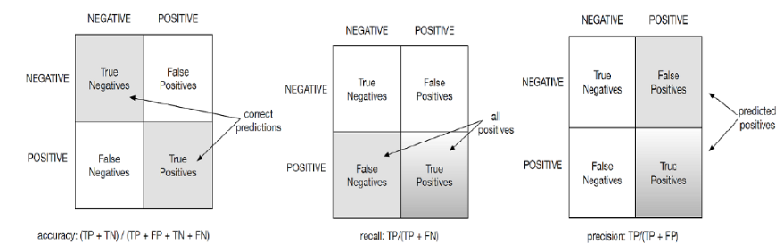
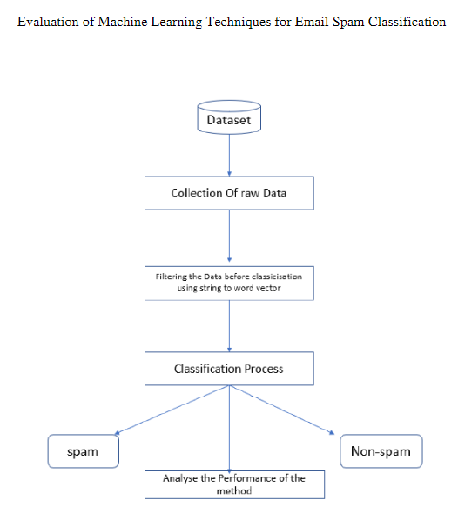
As this shows the accuracy ,recall and presicion to detect a spam.To calculate spam we use:
ACCURACY :(TP+TN)/(TP+FP+TN+FN)
RECALL:TP/(TP+FN)
PRECISION:TP/(TP+FP)

Slide 15
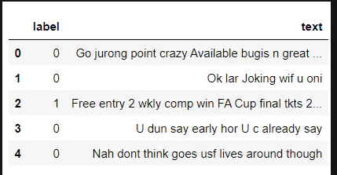
REMOVING PUNCTUATIONS AND STOP WORDS FROM MESSAGE:
Punctuation and stop words do not contribute anything to our model, so we have to remove them. Using NLTK library we can easily do it.
PROGRAM:
import nltk
nltk.download('stopwords')
import string def text_process(text):
text = text.translate(str.maketrans('', '', string.punctuation))
text = [word for word in text.split() if word.lower() not in stopwords.words('english')]
return " ".join(text)
data['text'] = data['text'].apply(text_process)
data.head()
Now, create a data frame from the processed data before moving to the next step.
text = pd.DataFrame(data['text'])
label = pd.DataFrame(data['label'])

Slide 16
CONVERTING WORDS INTO VECTOR :
we can convert words to vectors using either Count Vectorizer or by using TF-IDF Vectorizer.
TF-IDF is better than Count Vectorizers because it not only focuses on the frequency of words present in the corpus but also provides the importance of the words.
We can then remove the words that are less important for analysis, hence making the model building less complex by reducing the input dimensions.
## Counting how many times a word appears in the dataset from collections
import Counter
total_counts = Counter()
for i in range(len(text)):
for word in text.values[i][0].split(" "):
total_counts[word] += 1
print("Total words in data set: ", len(total_counts))
# Sorting in decreasing order (Word with highest frequency appears first) :
vocab = sorted(total_counts, key=total_counts.get, reverse=True)
print(vocab[:60])

Slide 17
# Text to Vector
def text_to_vector(text):
word_vector = np.zeros(vocab_size)
for word in text.split(" "):
if word2idx.get(word) is None:
continue
else:
word_vector[word2idx.get(word)] += 1
return np.array(word_vector)
# Convert all titles to vectors
word_vectors = np.zeros((len(text), len(vocab)), dtype=np.int_)
for i,(_, text_) in enumerate(text.iterrows()):
word_vectors[i] = text_to_vector(text_[0]) word_vectors.shape

Slide 18
CLASSIFYING USING SKLEARN’S PREBUILT CLASSIFIER:
CLASSIFIER USED:
1. spam classifier using logistic regression
2.email spam classification using Support Vector Machine(SVM)
3.spam classifier using naive bayes
4.spam classifier using decision tree
5.spam classifier using K-Nearest Neighbor(KNN)
6.spam classifier using Random Forest Classifier
We will make use of sklearn library.
#import sklearn packages for building classifiers
from sklearn.linear_model import LogisticRegression
from sklearn.svm import SVC
from sklearn.naive_bayes import MultinomialNB
from sklearn.tree import DecisionTreeClassifier
from sklearn.neighbors import KNeighborsClassifier
from sklearn.ensemble import RandomForestClassifier
from sklearn.metrics import accuracy_score

Slide 19
#initialize multiple classification models
svc = SVC(kernel='sigmoid', gamma=1.0)
knc = KNeighborsClassifier(n_neighbors=49)
mnb = MultinomialNB(alpha=0.2)
dtc = DecisionTreeClassifier(min_samples_split=7, random_state=111)
lrc = LogisticRegression(solver='liblinear', penalty='l1')
rfc = RandomForestClassifier(n_estimators=31, random_state=111)
#create a dictionary of variables and models
clfs = {'SVC' : svc,'KN' : knc, 'NB': mnb, 'DT': dtc, 'LR': lrc, 'RF': rfc}
By using different classification we can detect the spam in a mail.
Detecting can ce done in many methods like naïve bayes,sklearn etc..
There are some libraries which can be used to detect a spam.

Slide 20
MODEL PREDICTION:
Program: To predict whether spam is their or not.
def find(x):
if x == 1:
print ("Message is SPAM")
else:
print ("Message is NOT Spam")
newtext = ["Free entry"]
integers = vectorizer.transform(newtext)
x = mnb.predict(integers)
find(x)
The output will be resulted if the spam is present then it will print “Message is SPAM” or else “Message id NOT spam”.
After all prediction we have check the classification using Confusion Matrix.
CONFUSION MATRIX:
A confusion matrix is a table that is used to define the performance of a classification algorithm. A confusion matrix visualizes and summarizes the performance of a classification algorithm.

Slide 21
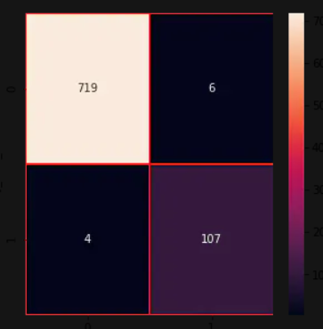
By using confusion matrix we can evaluate classification models.
This confusion matrix uses naïve bayes algorithm and sklearn.
from sklearn.metrics import confusion_matrix
import seaborn as sns
# Naive Bayes
y_pred_nb = mnb.predict(X_test)
y_true_nb = y_test
cm = confusion_matrix(y_true_nb, y_pred_nb)
f, ax = plt.subplots(figsize =(5,5))
sns.heatmap(cm,annot = True,linewidths=0.5,linecolor="red",fmt = ".0f",ax=ax)
plt.xlabel("y_pred_nb")
plt.ylabel("y_true_nb")
plt.show()
And this confusion matrix is the conclusion to detect the spam and ham in the mail and someother source of network.

Slide 22
ADVANTAGES OF DETECTING SPAM:
It Streamlines Inboxes.
Protect Against Malware.
Keeps You Compliant.
It Saves You Money.
Security risk can be reduced.
Challenges of Spam Detection:
1.The growing amount of data on the Internet with various new features is a big challenge for spam detection systems.
2.Features’ evaluation from several dimensions such as temporal, writing styles, semantic, and statistical ones is also challenging for spam filters.
3.Most of the models are trained on balanced datasets, while self-learning models are not possible.
4.Many spam detection models face adversarial machine learning attacks that will decrease their effectiveness. Adversaries can throw a variety of attacks during the training and testing of ML models.

Slide 23
5.Deep fake is another big challenge that is being faced by spam detection systems. To generate, modify, and style pictures and videos, neural network models such as GPT-2,3 and image generation models like BigGAN, StyleGAN, and CycleGAN are adopted.
6.Deep fakes can be used to disseminate false information.
Conclusion:
Spam detection and filtration gained the attention of a sizeable research community. The study compares these approaches and provides a summary of learned lessons from each category. This study concludes that most of the proposed email and IoT spam detection methods are based on supervised machine learning techniques. A labeled dataset for the supervised model training is a crucial and time-consuming task. Supervised learning algorithms SVM and Naïve Bayes outperform other models in spam detection. The study provides comprehensive insights of these algorithms and some future research directions for email spam detection and filtering.

